Slide 1

WoodStreet
Furniture shopping using
Augmented reality
Mehmud Malek
Hasnain Quraishi
Naim Rangrej
Created By :

Slide 2
WoodStreet
In current time when you were buying a chair, a lamp, a carpet, or anything else? Remember how we excited you were about the furniture purchase, rushing home. And find out that an item did not fit in the room. And there were in two further options: either returns the goods and goes back to the start, or leave and live with it. Fortunately, with new tech advances and stuff like Augmented Reality you can place virtual furniture check whether its looks better or not. And also check the furniture information in details.
In this application user can apply the furniture object and set the 3d object in place. So User can easily check the furniture is suitable or not. In WoodStreet App there are some Augmented Reality Features, so user is fully satisfied with this technology.

Slide 3
INDEX Company Profile ................................................................ 04 Tools and Technology................................................................ 06
System Requirement ................................................................ 07
Existing System ................................................................ 08
Propose System ................................................................ 09 Use case Diagram ................................................................ 11
Activity Diagram ................................................................ 12 Class Diagram ................................................................ 13 Sequence Diagram ................................................................ 14
State Chart Diagram ................................................................ 16 Data dictionary ................................................................ 17 Sample Screen ................................................................ 22 Conclusion ................................................................ 29

Slide 4
COMPANY PROFILE
Company Name :- Jarvis Technolabs
Contact Number:- + 91-79-48003966
Company Address :- E-1212,TitaniumCity Centre, Near Sachin Tower, 100 ft. Road,Satellite, Ahmedabad, Gujarat-380015

Slide 5
Project Profile
WoodStreet

Slide 6
WoodStreet
Tools:-
Android Studio
Unity 3D
3D Max Studio
MYSQL
Technologies :-
Augmented Reality
Vuforia
PHP
My SQL Database

Slide 7
System Requirement
Software Requirement:-
Android Studio
Android SDK
Android Device with update Version(7.0)
Hardware Components:-
Processor – i3
Hard Disk – 200 GB
Memory – 4GB RAM

Slide 8
Existing System:-
Currently “ Pepperfry ”online Furniture store is available in the market and is more popular but it do not provide Augment Reality (Virtual Reality) features that’s why customers are not able to take correct decision how furniture will look like and which color will suit best in their area room

Slide 9
Proposed System:-
The application will help the user to scan the place where we want to keep the furniture and it will fill the place with virtual furniture in 3D view.
Through this system we will get rid of the difficulties of fitting the furniture in the place. Normally we buy furniture and bring home, after that we find that the furniture is not fitting in that place. So it will help the user to choose the right furniture for that particular place.
It will also help the user to choose the look, colour and size of the furniture as we can see that place with furniture in virtual 3D view.

Slide 10
UML Diagrams
WoodStreet

Slide 11
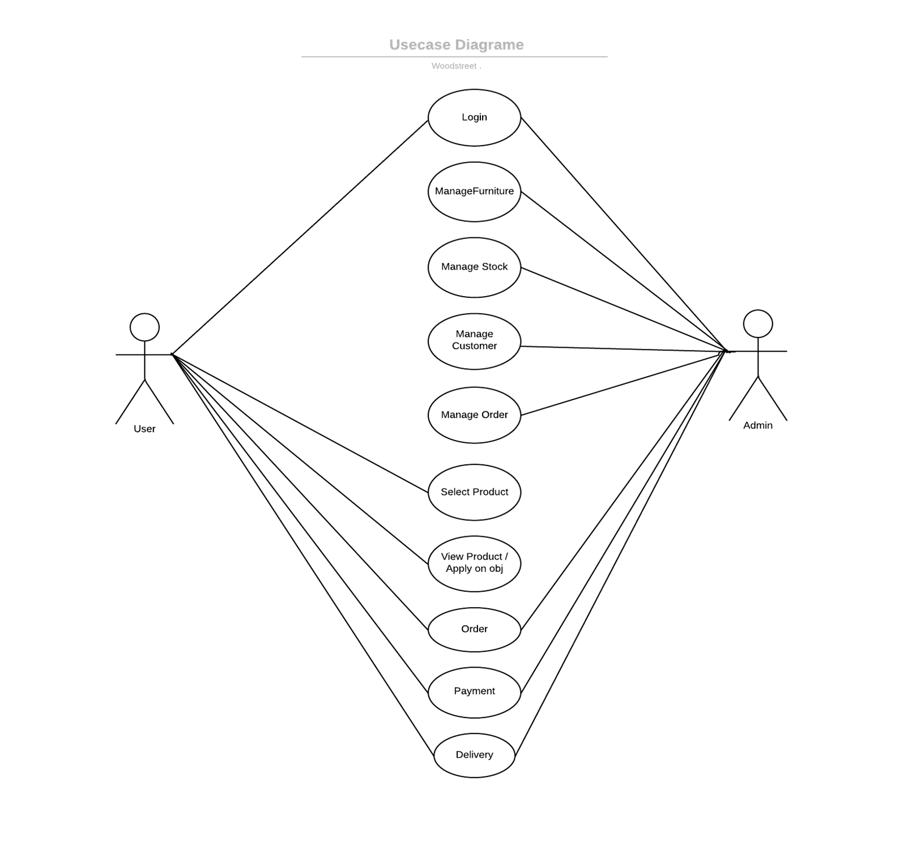
Use case Diagram :-

Slide 12
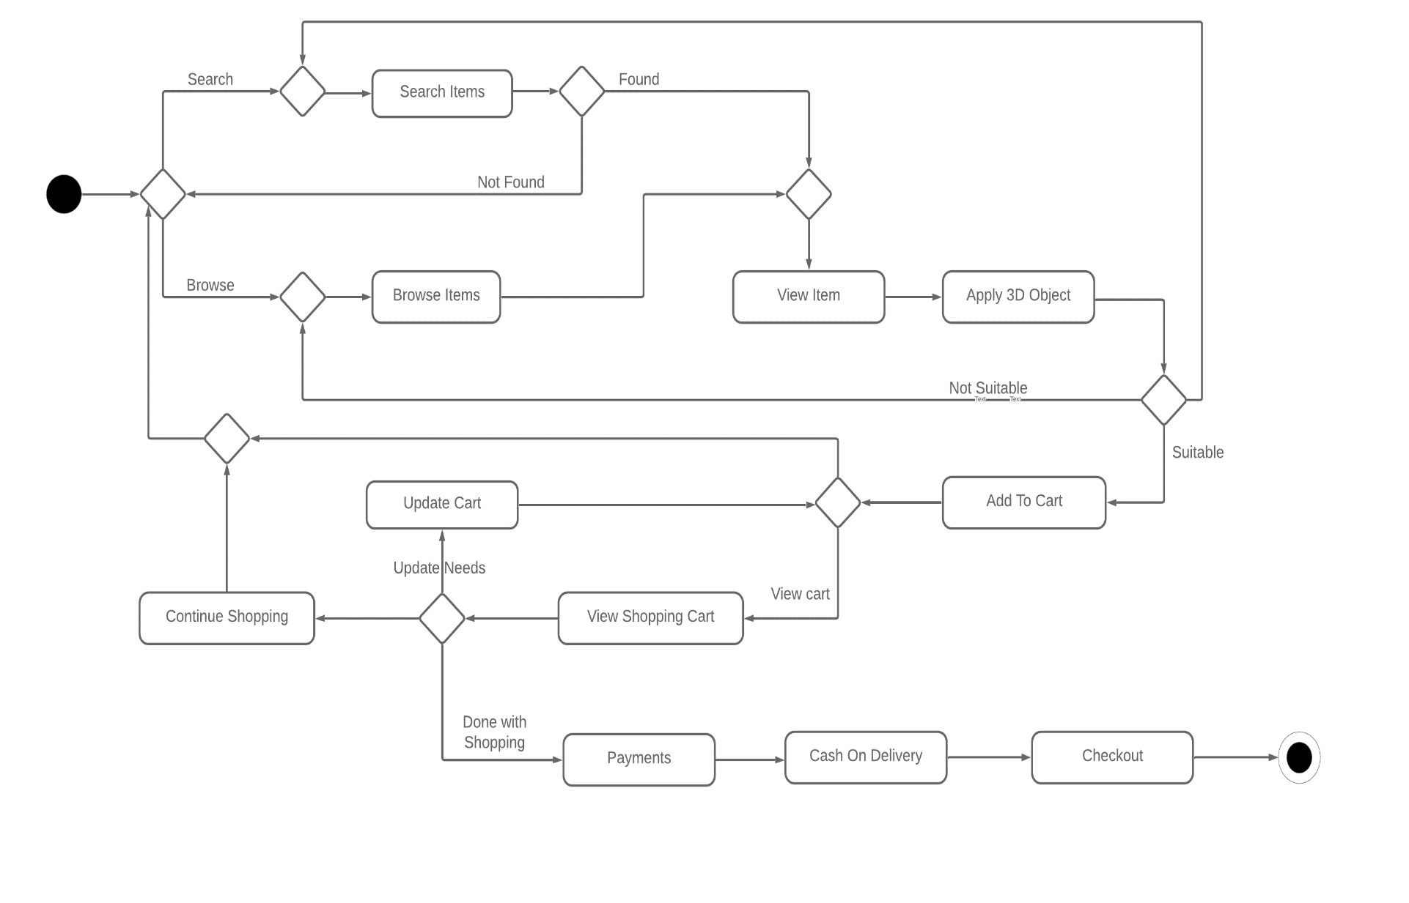
Activity Diagram :-

Slide 13
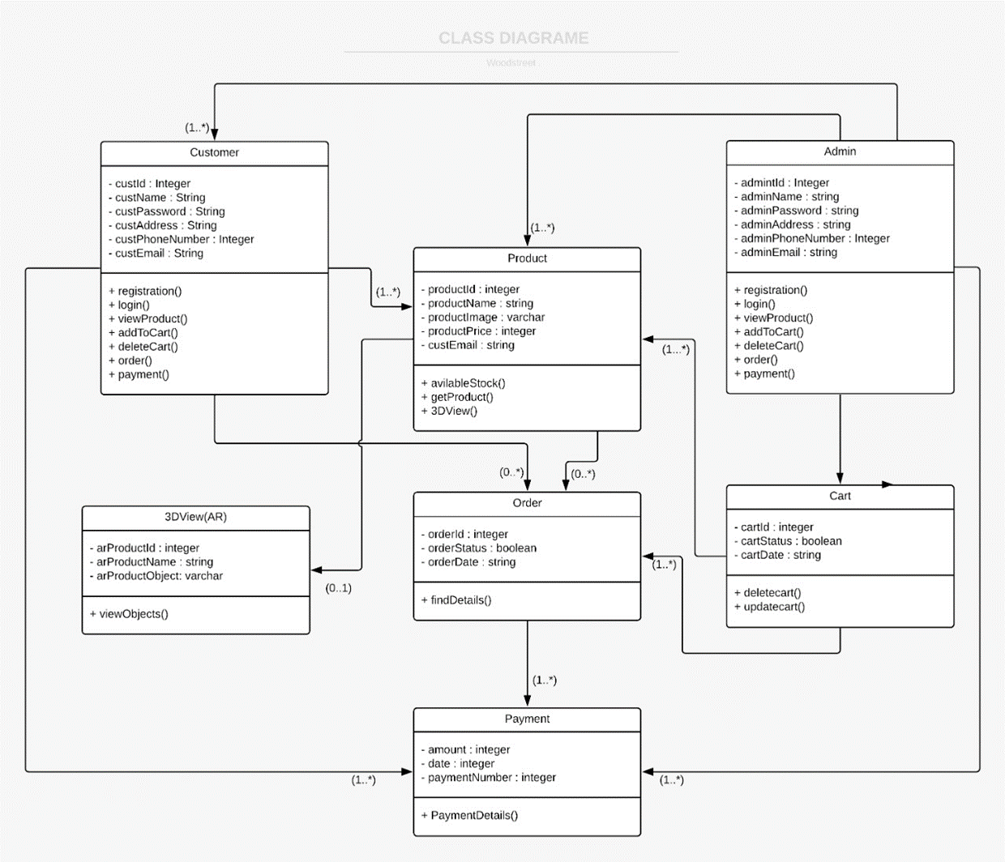
Class Diagram :-

Slide 14
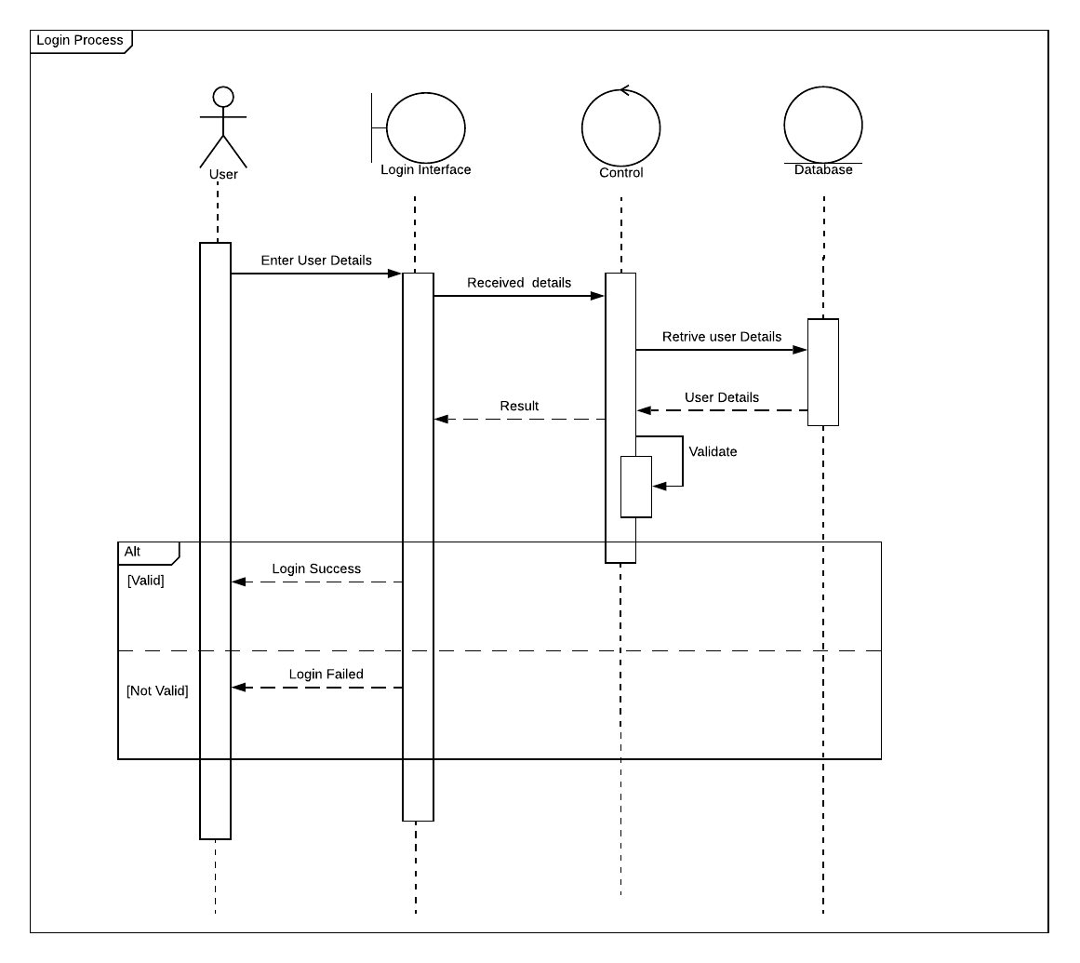
Sequence
Diagram :-

Slide 15
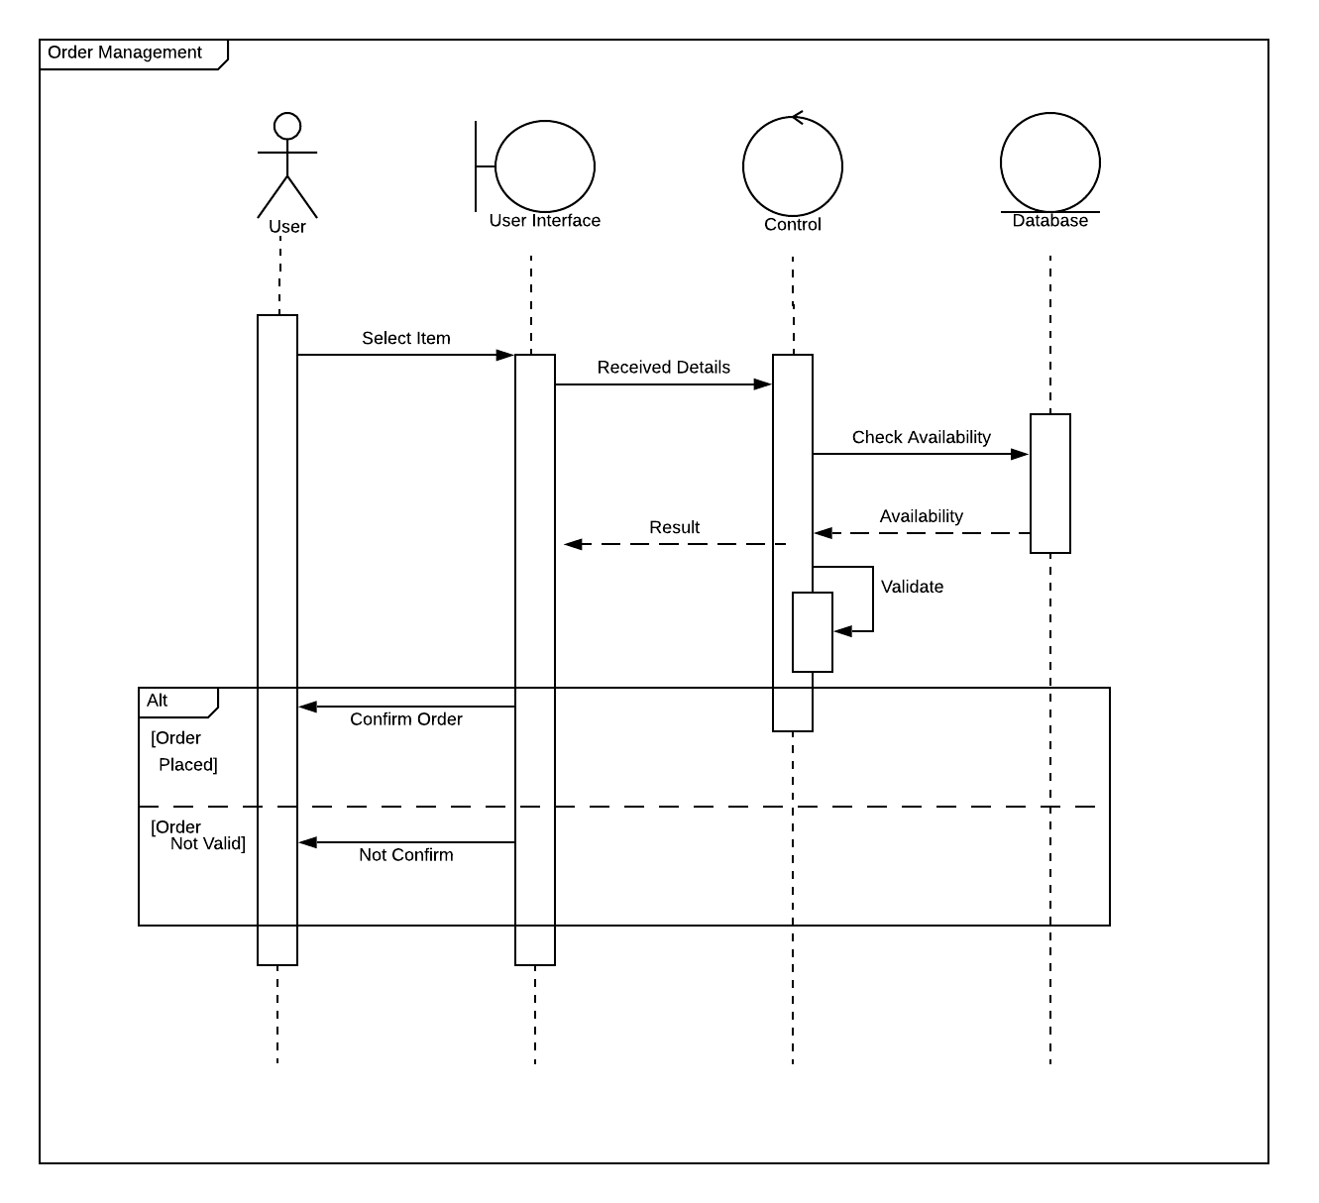
Sequence
Diagram :-

Slide 16
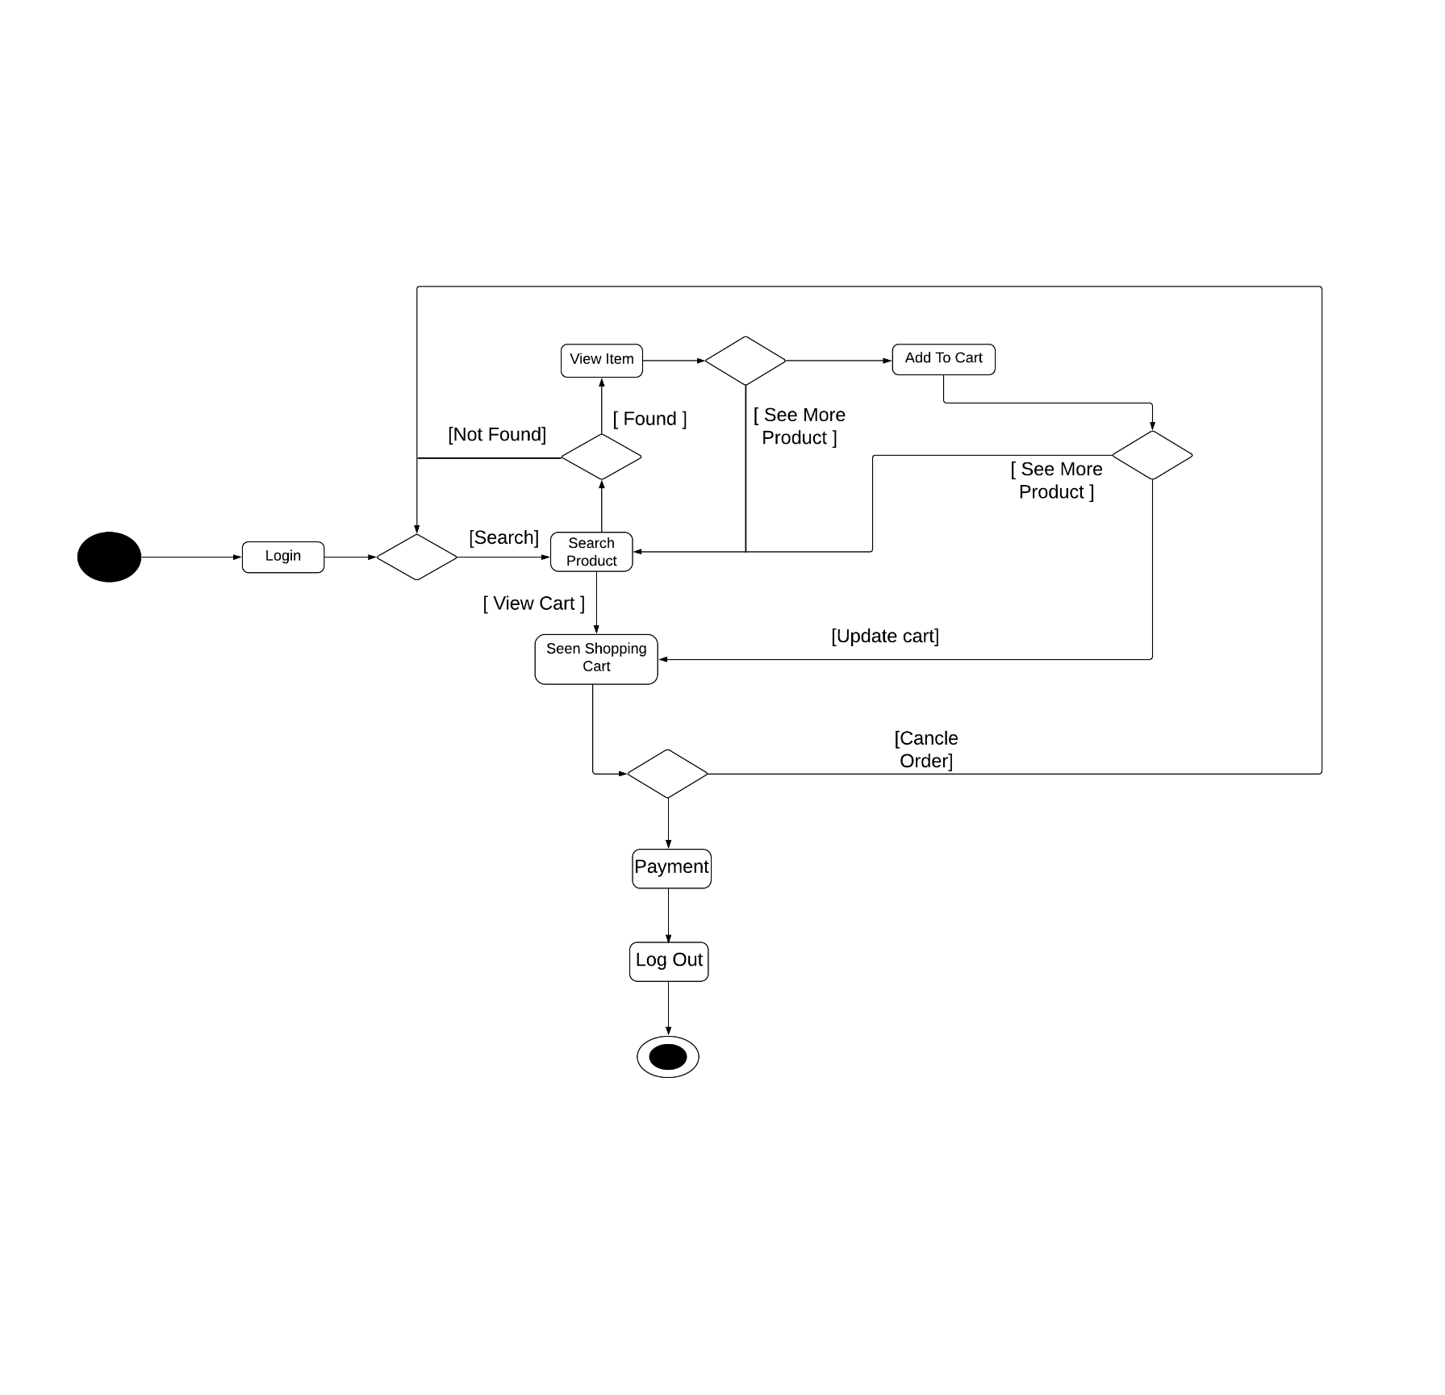
State chart Diagram :-

Slide 17
Data Dictionary
WoodStreet

Slide 18
ADMIN_TABLE
FieldName | Datatype | Constraint | Description
Admin_id | Int(50) | Primary Key | Unique Identify
Admin_email | Varchar(50) | NOT NULL | Email Of Admin
Admin_mobile_no | Number(10) | NOT NULL | Mobile No Of Admin
Admin_name | Varchar(50) | NOT NULL | Name Of Admin
Admin_password | Varchar(50) | NOT NULL | Password of Admin
CUSTOMER_TABLE
Field Name | Datatype | Constraint | Description
User_id | Int(50) | PrimaryKey,auto increament | Identify Of User
First_name | Varchar(50) | NOT NULL | Name Of User
Last_name | Varchar(50) | NOT NULL | Family Name Of User
Mobile_no | Number(10) | NOT NULL | Phone No Of User
Password | Varchar(50) | NOT NULL | Password Of User
Address | Varchar(50) | NOT NULL | Address Of User

Slide 19
PRODUCT_TABLE
FieldName | Datatype | Constraint | Description
Product_id | Int(50) | Primary Key | Identify
Product_name | Varchar(50) | NOT NULL | Name of product
Category_id | Int(50) | ForeignKey | Identify Category
Product_price | Float(10) | NOT NULL | Price Allocated To Item
Product_img | Varchar(50) |  | Location Of Image
Stock | Boolean |  | Available Or Not
CATEGORY_TABLE
FieldName | Datatype | Constraint | Description
Category_id | Int(50) | Primary Key | Identify Of Category
Sub_category_id | Int(50) | ForeignKey | Identify of sub_category
Tittle | Varchar(50) | NOT NUUL | Tittle Assign to Category

Slide 20
SUB_CATEGORY_TABLE
FieldName | Datatype | Constraint | Description
Sub_category_id | Int(50) | PrimaryKey | Identification Of Sub_cat
Sub_Category_name | Varchar(50) | NOT NULL | Identification Of Sub_cat Name
Category_id | Int(50) | ForeingKey | Identification Of Category_id
CART_TABLE
FieldName | Datatype | Constraint | Description
Cart_id | Int(50) | Primary Key | Unique Identify
Product_id | Int(50) | ForeignKey | Product Identification
Sub_category_id | Int(50) | ForeignKey | Identification Of Sub_cat
User_id | Int(50) | ForeignKey | Identification Of User
Product_price | Float(10) | NOT NULL | Price of particular product
Product_Quantity | Int(50) |  | Total No Of Product
Total | Float(50) |  | Sum Of All Item In Rupee

Slide 21
ORDER_TABLE
FieldName | Datatype | Constraint | Description
Order_id | Int(50) | Primary Key,auto increamant | Unique Identify Of Order
User_id | Int(50) | ForeignKey | User associated With Order
Alternate_Address | Varchar(50) |  | Alternative Address
Cart_id | Int(50) | ForeignKey | Cart Associated With Order
Date | Datetime | NOT NULL | Date and Time Of Order
Payment_type | Boolean | NOT NULL | Method Used For Payment (COD)

Slide 22
Sample Screen Layouts
WoodStreet

Slide 23
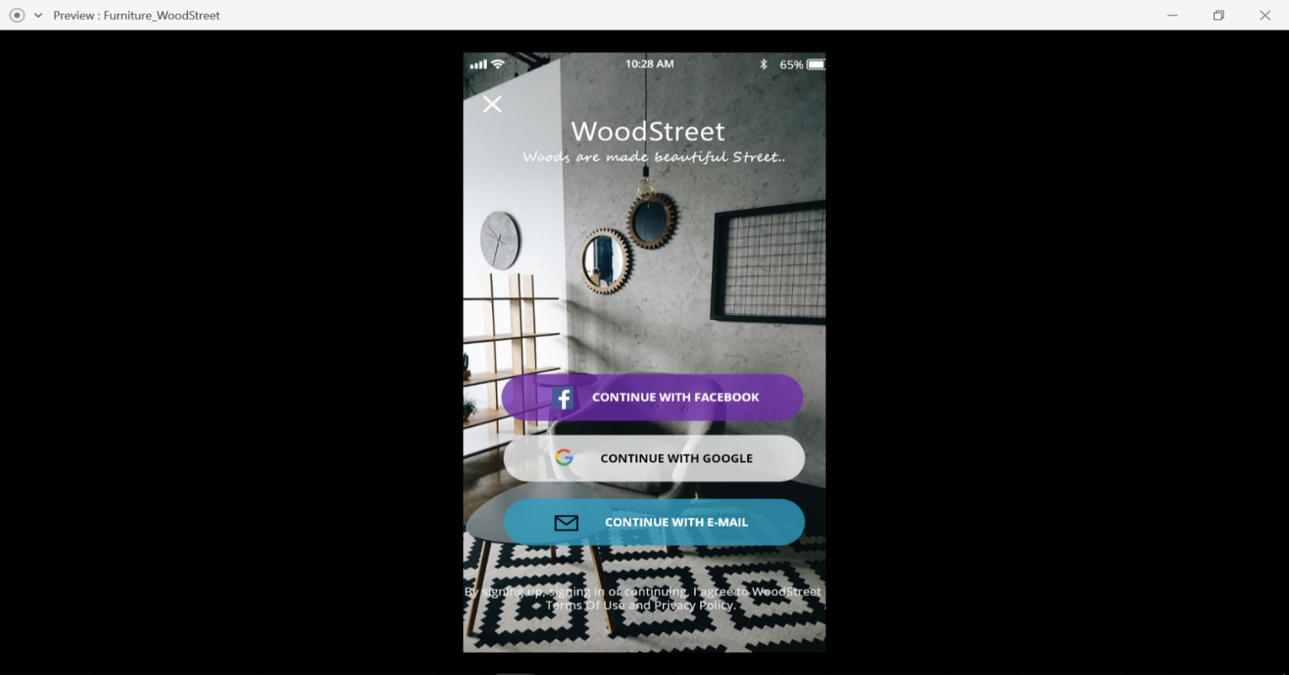
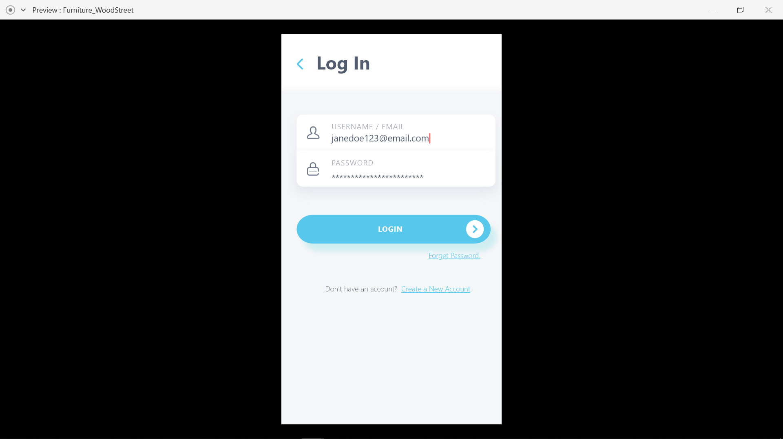
Login :-

Slide 24
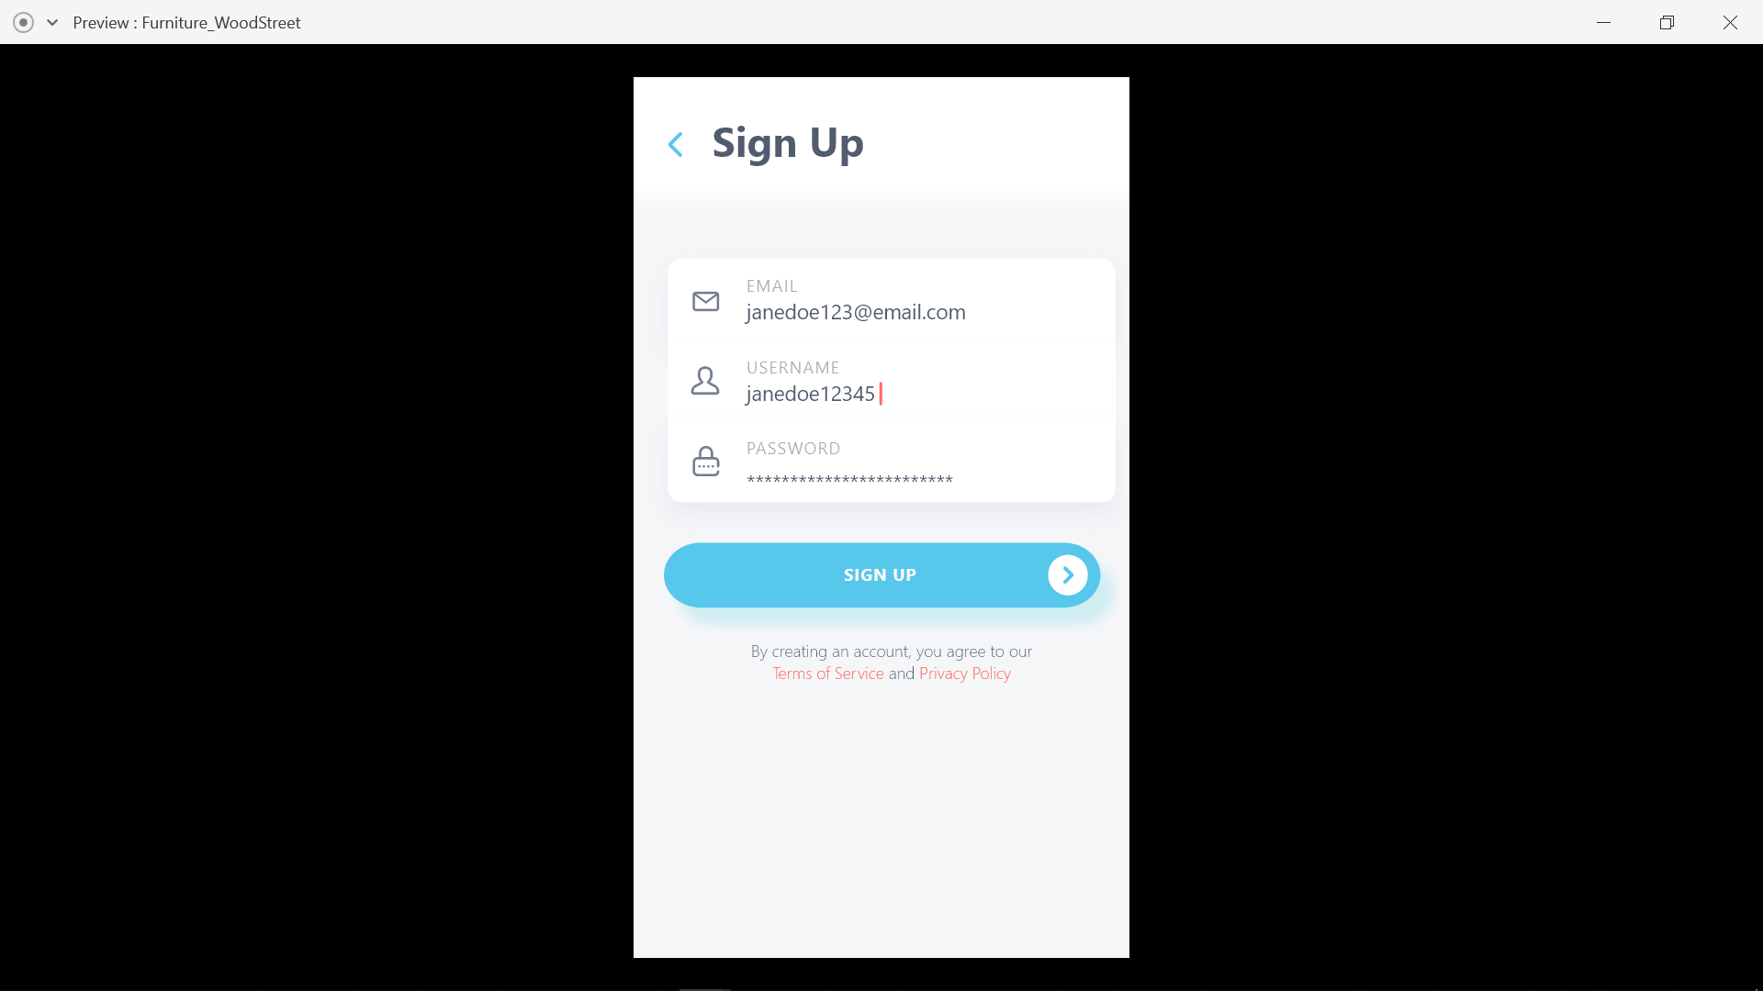
Sign Up:-

Slide 25
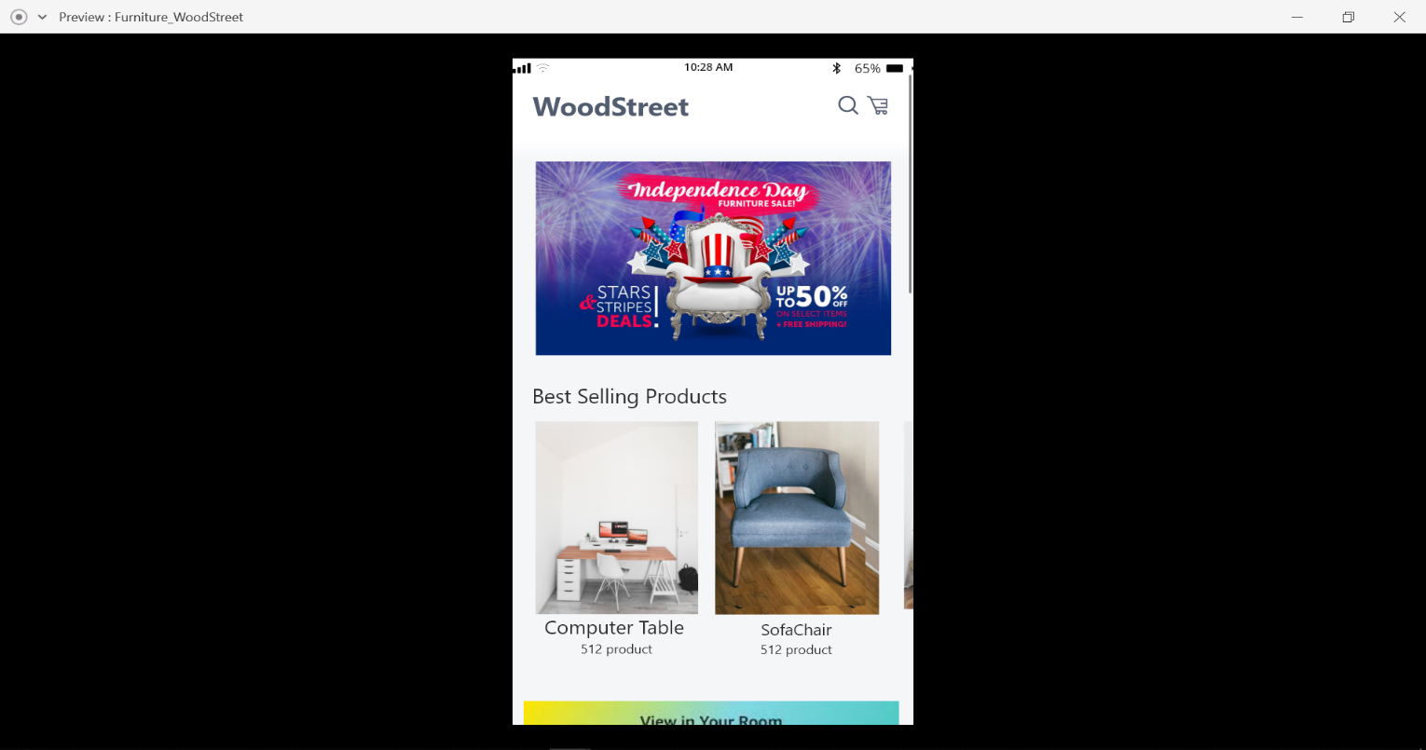
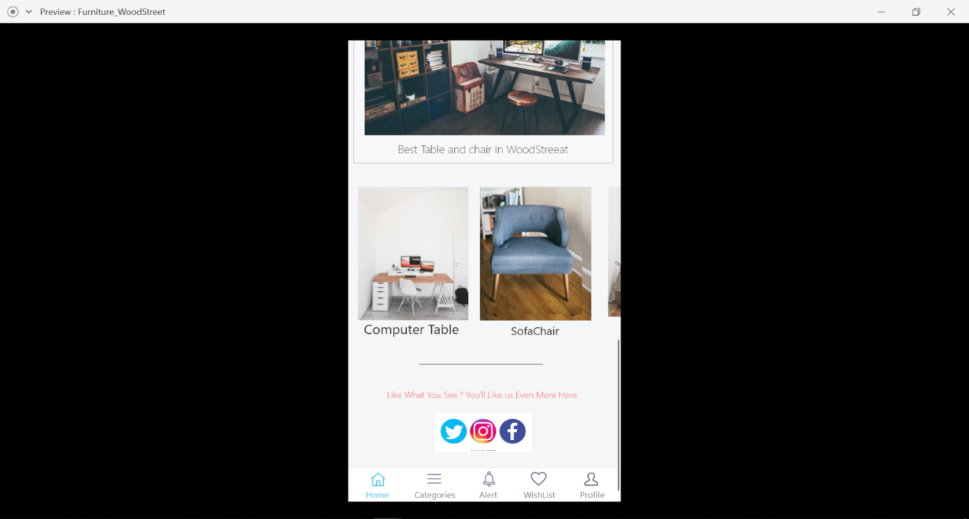
Home page:-

Slide 26
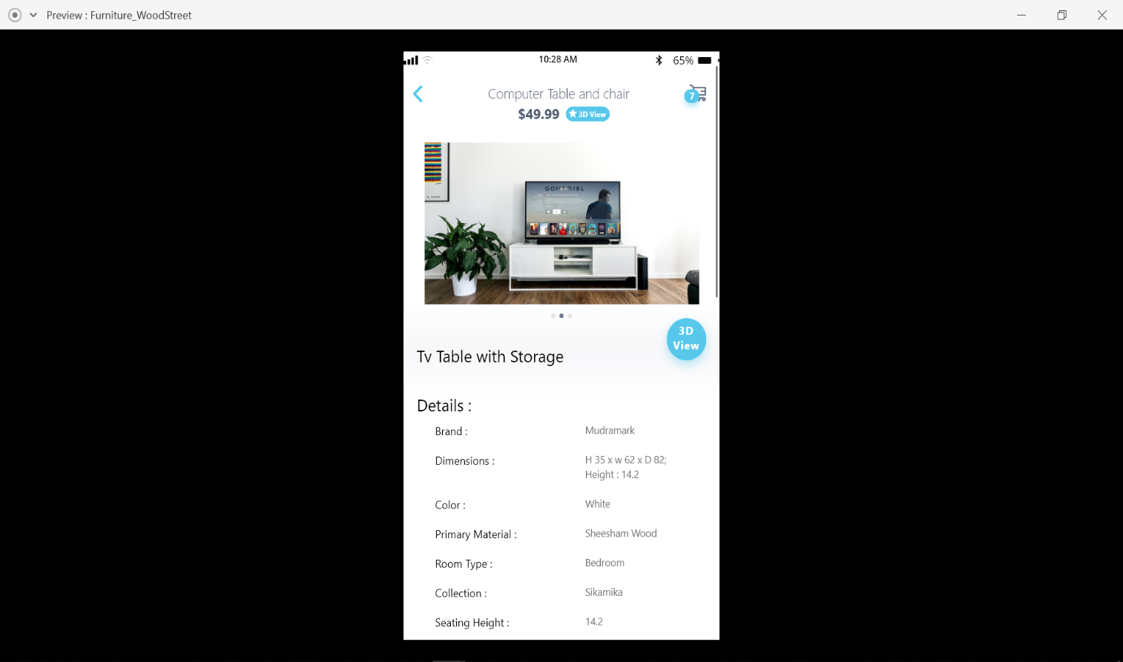
Details of product:-

Slide 27
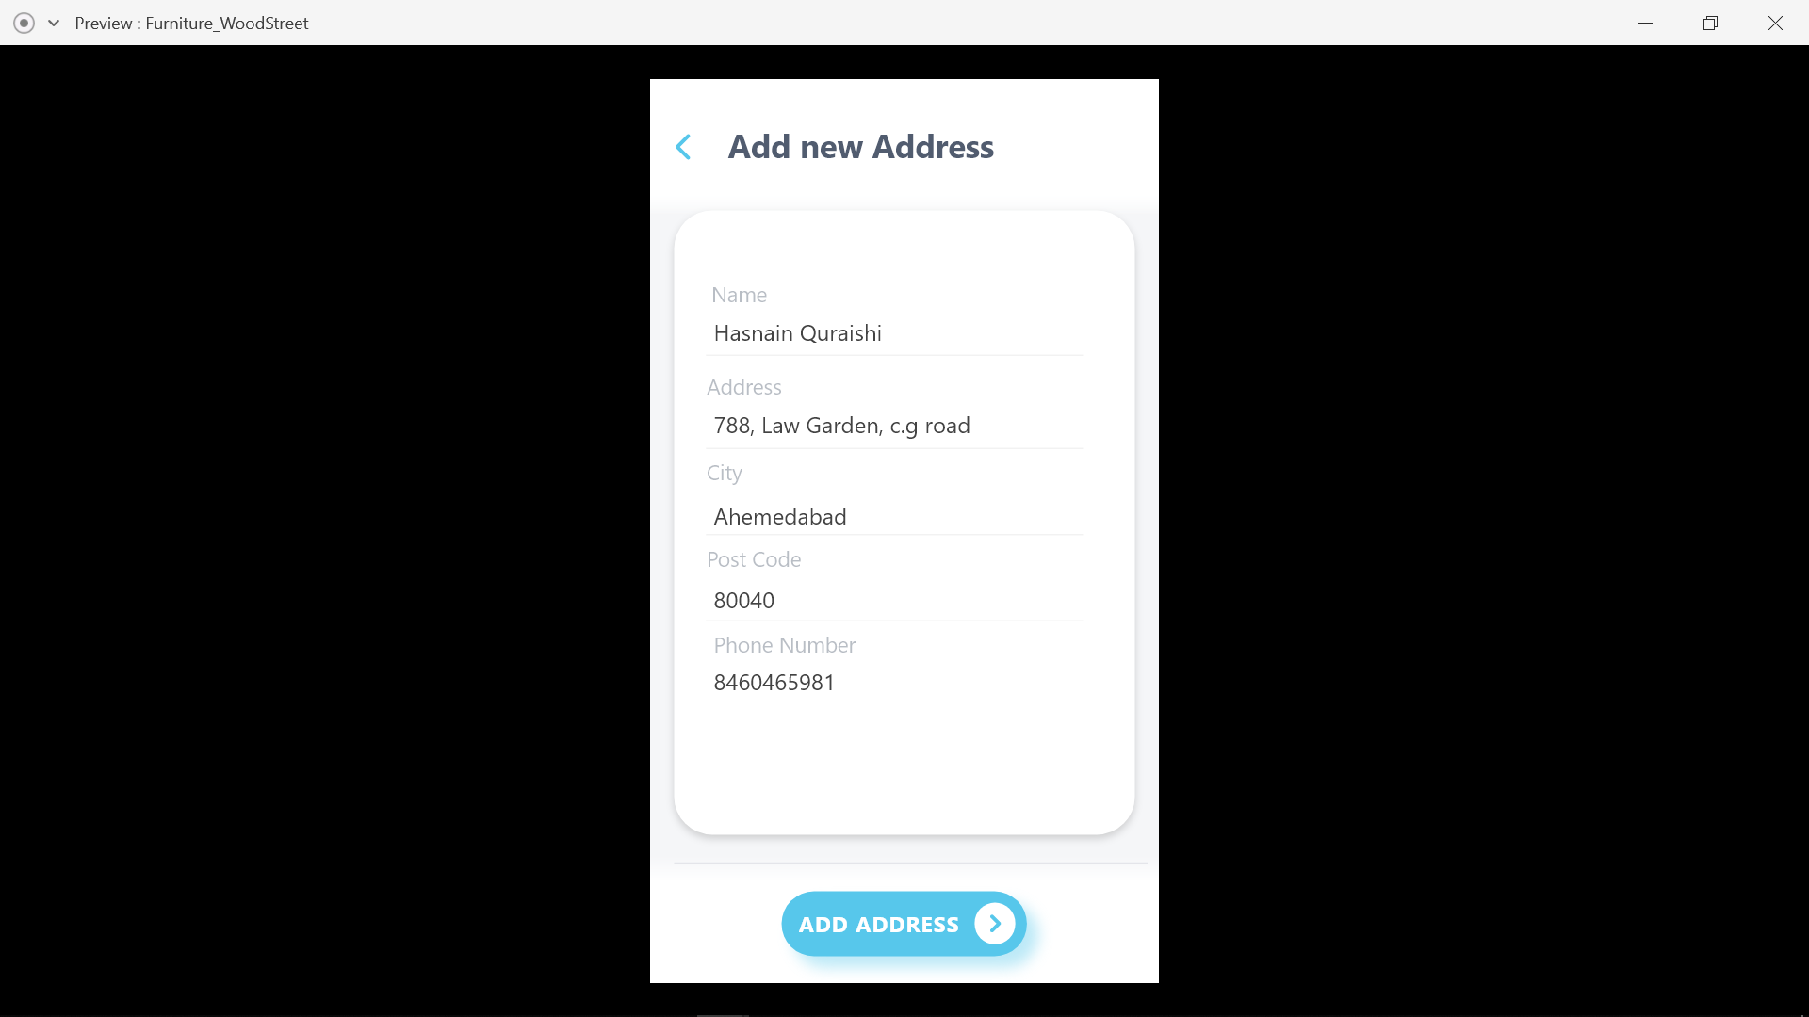
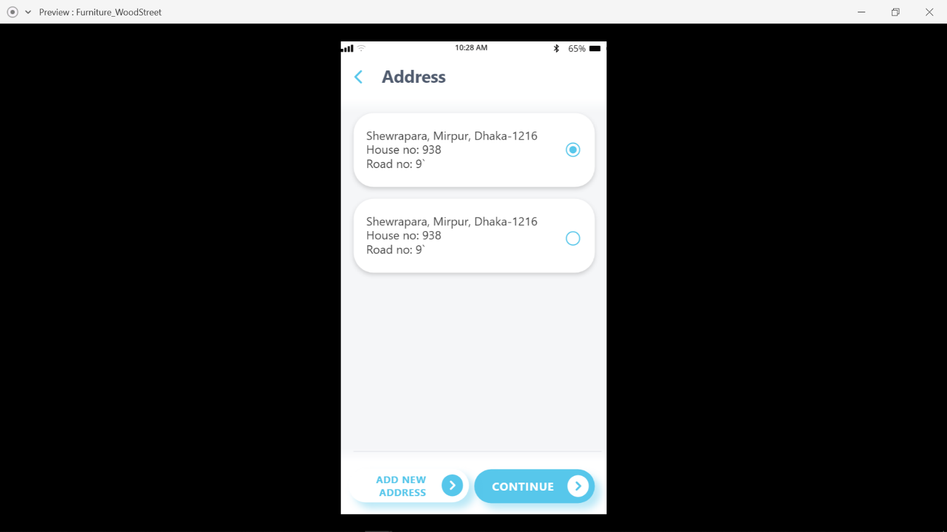
address details:-

Slide 28
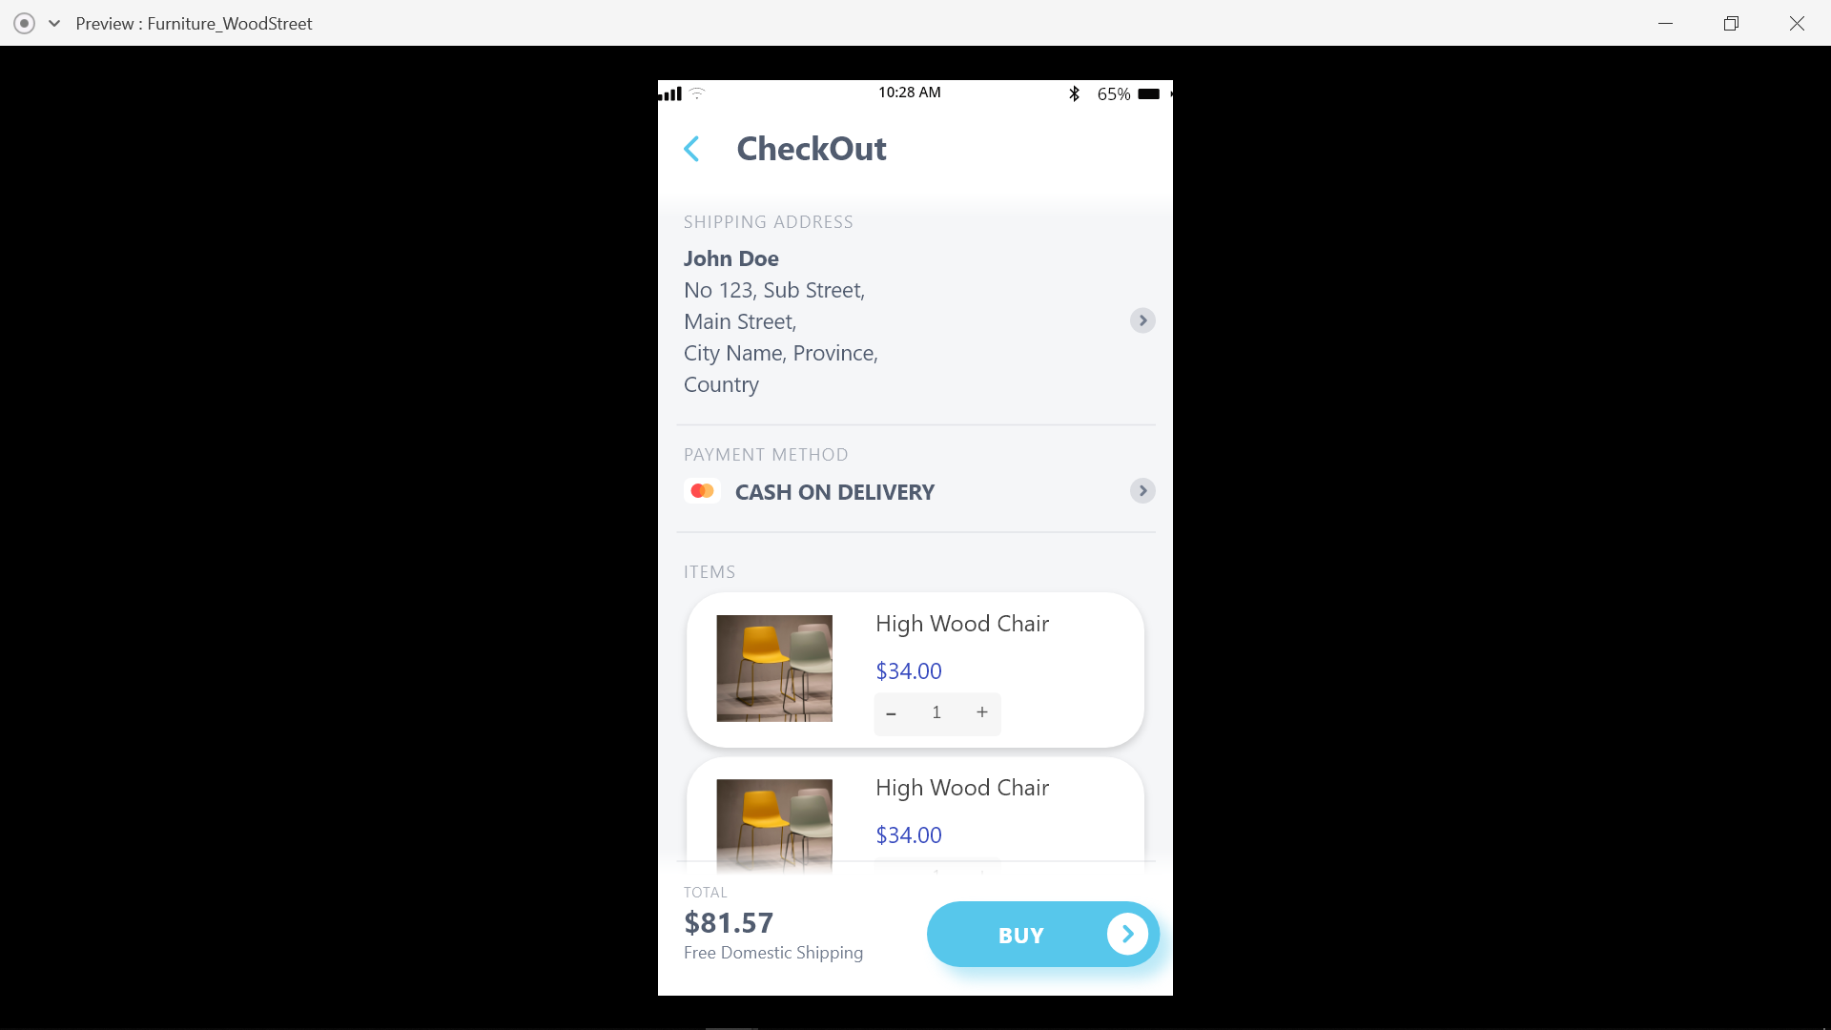
cart:-

Slide 29
Conclusion
It was a wonderful and learning experience for us while working on this project. This project took us through the various phases of project development and gave us real insight into the world of software and programming. The joy of working and the thrill involved while tackling the various problems and challenges gave us a feel of developer’s industry.
I sincerely thanks to my parents, group members, internal guide i.e. Prof. Bharti shah, external guide Jainam Jhaveri and other faculty members and GLS Faculty of Computer Applications & IT for their sole support at every step of this project.

Slide 30
Thank you..!

